Slide 1
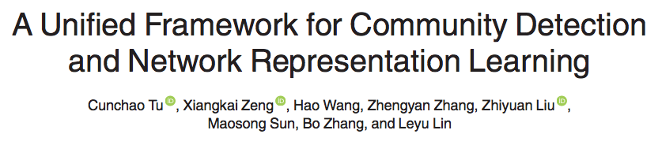

Slide 2
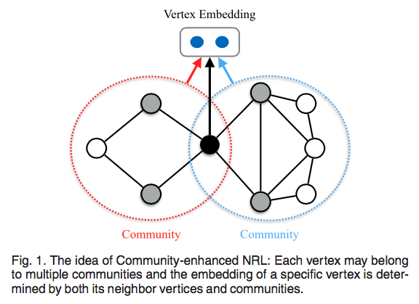
DeepWalk and LINE can only reflect local patterns
Vertices in a community usually share certain common attributes.
Community-enhanced NRL (CNRL)

Slide 3
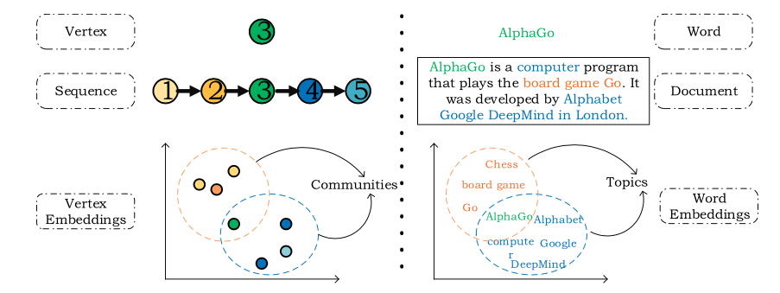
assuming that there exists an intermediate state between random walk sequences and vertices, i.e., communities, which corresponds to the topics between text and words.
detect communities and learn network representations by employing topic modeling methods.

Slide 4
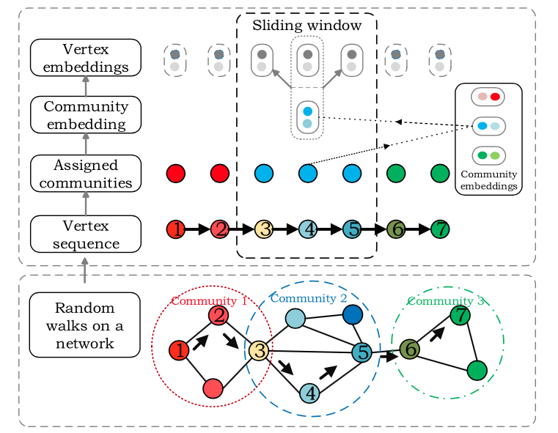
each vertex is grouped into multiple communities
these communities are overlapping.
Notes:
根据主题模型的思想，根据顶点的社区分布和序列的社区分布，为特定序列中的每个顶点分配特定的社区。然后，应用每个顶点及其指定的社区来预测游走序列中的上下文节点。因此，通过最大化预测可能性来学习顶点和社区的表示。注意，顶点的社区分布也在表示学习过程中迭代地更新。在CNRL中学习的社区表示将用于增强网络分析任务中的顶点表示，例如顶点分类和链接预测。更重要的是，社区表示有望使那些具有较少本地上下文信息的长尾顶点受益。

Slide 5
conduct the following two steps iteratively to detect community structures and learn representations of vertices and communities:
Community Assignment.
We assign a discrete community label for each vertex in a particular walk sequence, according to both local context and global community distribution.
Representation Learning.
Given a vertex and its community label, we learn optimized representations to maximize the log probability of predicting context vertices.
Notes:
1）社区分配。我们根据局部上下文和全局社区分布为特定游走序列中的每个顶点分配离散社区标签。 （2）表征学习。给定顶点及其社区标签，我们学习优化表示以最大化预测上下文顶点的对数概率。

Slide 6



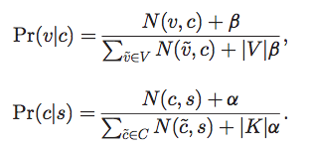
Community Assignment
Statistic-Based Assignment
Notes:
Nðv;cÞ indicates how many times the vertex v is assigned to the community c, and Nðc;sÞ indicates how many vertices in the sequence s are assigned to the community c. 两个都随社区分配的变化动态更新

Slide 7


Embedding-Based Assignment.
CNRL will obtain the embeddings of vertices and communities
s is the average of the embeddings of all vertices in s.
badly degrade the performance: vertex embedding is not exclusively learnt for measuring community membership.
Notes:
顶点嵌入并非专门用于评判社区成员

Slide 8


Representation Learning of Vertices and Communities
learn representations of both vertices and communities

Slide 9

Enhanced Vertex Representation
We has obtained representations of both vertices and communities, as well as community distribution of vertex
We can apply these results to build enhanced representation for each vertex (the original vertex representation v and its community representation v_{c} )

Slide 10
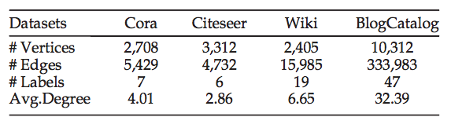
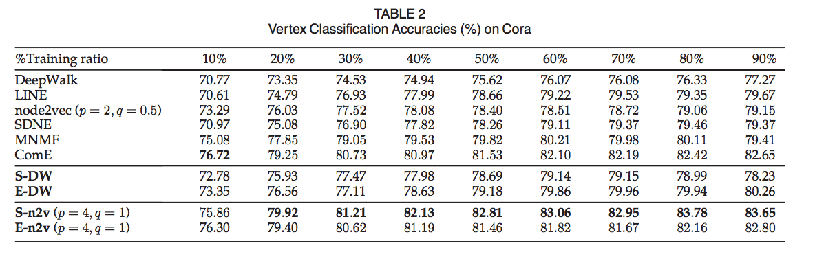

Slide 11
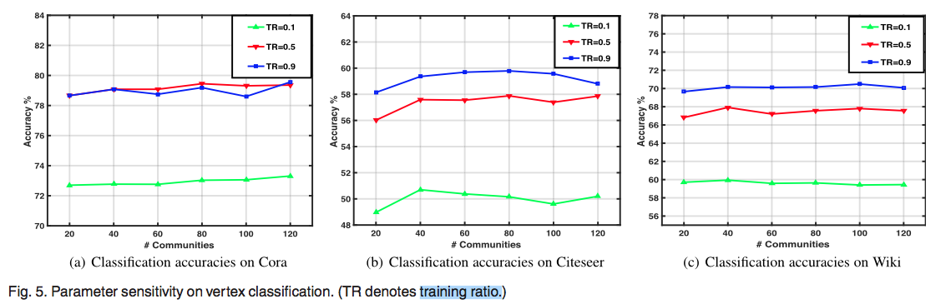
Notes:
我们的算法CNRL具有稳定性 当社区数量从20到120之间变化时，我们的模型可以适应在NRL期间检测不同数量的社区。

Slide 12
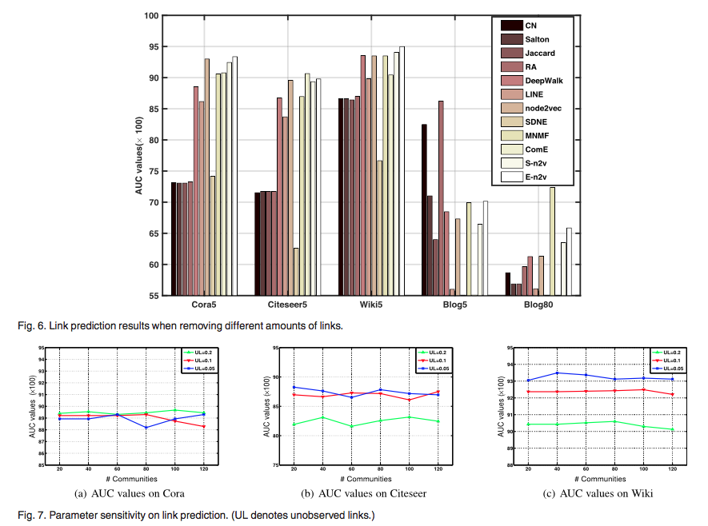

Slide 13
